Slide 1

CBII Banking Performance Dashboard
POWER BI DASHBOARD REPORT
Reported by: SANTOSH
2024/05/13

Slide 2
01 Customer Demographics Insights:
02 Loan Distribution Analysis:
03 Temporal Trends:
04 Regional Demand:
05 Loan Details:
06 Operational Metrics:
07 Risk Assessment:
08 Market Penetration and Growth Opportunities:
CONTENTS

Slide 3

Customer Demographics Insights:
Gender, Country, Nationality, and Property Type Analysis:
Use the slicer to examine how loan distribution varies across different demographics. Insights can include which nationality borrows the most, differences in loan uptake by gender, and which property types are most popular among different nationalities or in different countries.

Slide 4

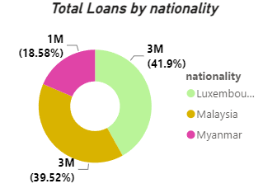
Loan Distribution Analysis:
Nationality and Total Loan (Donut Chart):
This visualization can provide insights into which nationalities have the highest total loan amounts, indicating either a higher number of loans or higher loan values per loan.

Slide 5
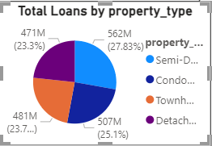
Loan Distribution Analysis:
Property Type and Total Loans (Pie Chart):
Analyze which types of properties are most financed and if there are significant differences in the loan amounts for different property types.

Slide 6
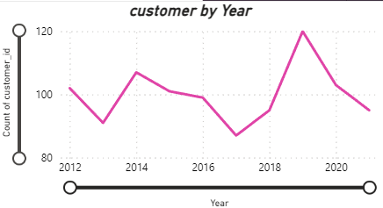
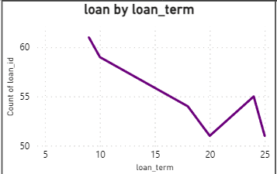
Temporal Trends:
Loan Term and Count of Loans (Line Chart):
Insights into the preferred loan terms can be useful for product tailoring and marketing.
Year and Count of Customers (Line Chart):
Trends over time can be crucial for identifying growth areas or times of decline. This can help in forecasting future trends based on past data.

Slide 7
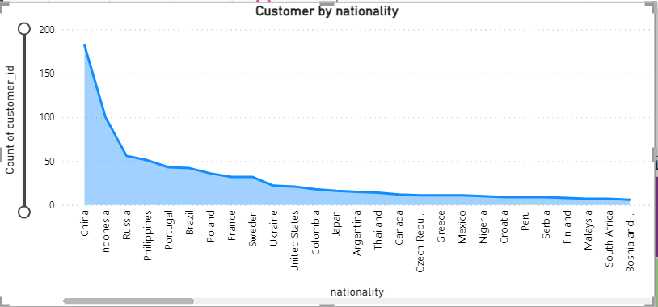

Regional Demand:
City and Count of
Customers (Line Chart):
Identifying cities with the highest customer count can guide regional marketing strategies and resource allocation.

Slide 8
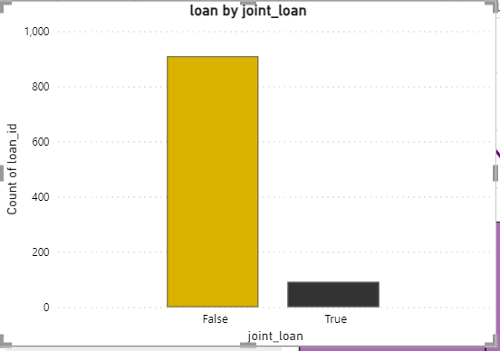
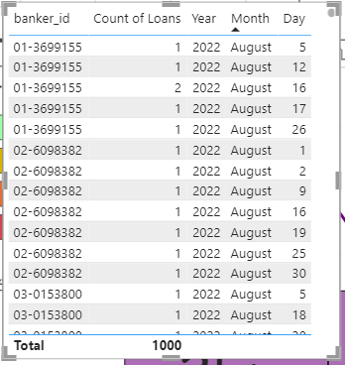
Loan Details:
Banker Performance (Table):
Analysis of banker performance based on the count of loans handled, which could highlight training needs or reward opportunities.
Joint Loan Analysis (Stacked Column Chart)::
This chart can provide insights into the popularity and success rates of joint loans versus individual loans.

Slide 9
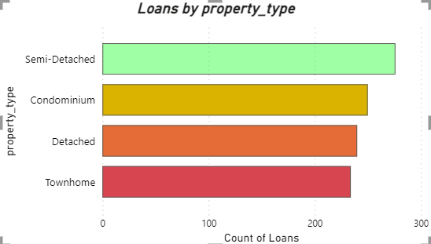

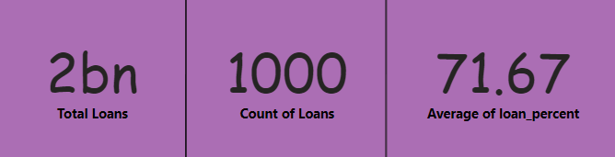

Operational Metrics:
Property Type Loan Dynamics (Stacked Bar Chart):
This can show which property types are more commonly financed, and if certain types are typically associated with higher loan counts.
- - - - - - - - - - - - - - - - - - - - - - - - - - - - - - - - - - - - - - - - - - - - - - - -- - - - - - - - - - - - - - - - - - - - - - - - - - - - - - - - - - -
Key Performance Indicators (Cards):
Total number of loans, customer count, and average loan percent are essential for quick assessment of business health and operational success.

Slide 10

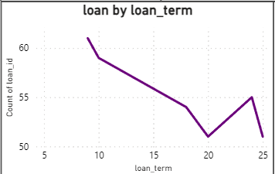
Risk Assessment:
Loan Term Versus Loan Count:
Longer term loans might indicate higher risk, and analyzing the distribution can help in risk management.

Slide 11
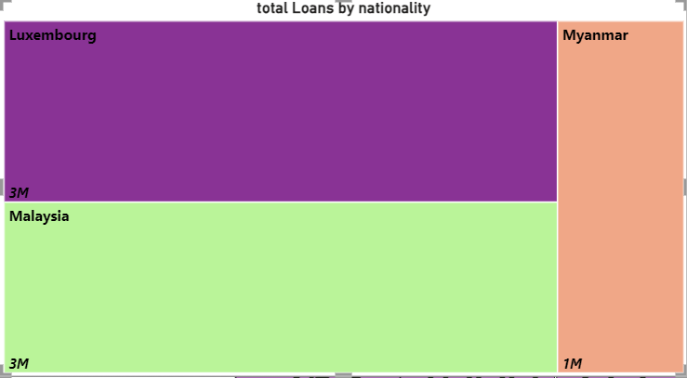

Market Penetration and Growth Opportunities:
Tree Map of Nationality and Total Loan:
Use this to identify potential markets for expansion or increased focus based on loan volume and customer nationality.

Slide 12
conclusion :
The comprehensive analysis of the bank data using the Power BI dashboard has provided crucial insights into customer demographics, loan distribution, and temporal trends, which collectively offer valuable opportunities for strategic decision-making and business enhancement. By dissecting customer behavior and preferences based on gender, nationality, property type, and loan characteristics, the bank can tailor its products and marketing strategies to better meet the needs of diverse customer segments.
The data reveals significant trends in loan uptake by region and nationality, highlighting potential areas for focused marketing and expansion. Moreover, the insights into the popularity and success rates of joint versus individual loans, combined with performance metrics from banker activity, empower the bank to optimize its service offerings and enhance staff training and reward systems.
Leveraging these insights, the bank can not only refine its product offerings and adjust its risk management strategies but also capitalize on emerging market opportunities to foster growth. By implementing the recommended data-driven strategies, the bank can enhance customer satisfaction, improve operational efficiencies, and achieve sustained growth, ensuring it remains competitive in a rapidly evolving financial landscape.

Slide 13
THANK YOU
NAME
PHONE
SANTOSH SG
6361315309
MAIL
linkedin
santoshgowdru15@gmail.com
www.linkedin.com/in/santosh-gowdru-68722b306

Slide 14
suitableFor financial industry summary report
departmental quarter
Summarize
XXday
reportPERSONAL YEAR-END SUMMARY REPORTReported by:rice husk
Son20XXYearXXmoon

